Slide 1
Classical Encryption Techniques

Slide 2
Terminologies
plaintext - original message
ciphertext - coded message
cipher - algorithm for transforming plaintext to ciphertext
key - info used in cipher known only to sender/receiver
encipher (encrypt)
  converting plaintext to ciphertext
decipher (decrypt)
  recovering ciphertext from plaintext
cryptography
  study of encryption principles/methods
cryptanalysis (codebreaking)
  study of principles/ methods of deciphering ciphertext without knowing key
cryptology
  field of both cryptography and cryptanalysis
Information Security

Slide 3
Symmetric key cryptography
An original message is known as the plaintext, while the coded message is called the cipher text.
The process of converting from plaintext to ciphertext is known as encryption or enciphering.
Restoring the plaintext from the ciphertext is known as decryption or deciphering.
Techniques used for deciphering a message without any knowledge of the enciphering details fall into the area of cryptanalysis.
Symmetric encryption is a form of cryptosystem in which encryption and decryption are performed using the same key. It is also known as conventional encryption.
Information Security

Slide 4
Symmetric key cryptography (Conti…)
Symmetric encryption transform plaintext into ciphertext using a secret key and an encryption algorithm. Using the same key and a decryption algorithm, the plaintext is recovered from the ciphertext.
Traditional symmetric ciphers use substitution and/or transposition techniques.
Substitution techniques map plaintext elements into ciphertext elements.
Transposition techniques systematically transpose the position of plaintext elements.
Rotor machines are sophisticated precomputer hardware devices that use substitution techniques.
Information Security

Slide 5

Symmetric cipher model
Information Security

Slide 6
Symmetric cipher model (Conti…)
There are two requirements for secure use of conventional encryption
1. we need a strong encryption algorithm. At a minimum, we would like the algorithm to be such that an opponent who knows the algorithm and has access to one or more ciphertexts would be unable to decipher the ciphertext or figure out the key.
This requirement is usually stated in a strong form: The opponent should be unable to decrypt ciphertext or discover the key even if he or she is in possession of a number of ciphertexts together with the plaintext that produced each ciphertext.
2.Sender and receiver must have obtained copies of the secret key in a secure fashion and must keep the key secure. If someone can discover the key and knows the algorithm, all communication using this key is readable.
Information Security

Slide 7
PLAYFAIR CIPHER
The Playfair cipher uses a 5 by 5 table containing a key word or phrase.
To generate the key table, one would first fill in the spaces in the table with the letters of the keyword (dropping any duplicate letters), then fill the remaining spaces with the rest of the letters of the alphabet in order
To encrypt a message, one would break the message into digraphs (groups of 2 letters) such that, for example, "HelloWorld" becomes "HE LL OW OR LD", and map them out on the key table.
Information Security

Slide 8
RULES
If both letters are the same (or only one letter is left), add an "X" after the first letter. Encrypt the new pair and continue. Some variants of Playfair use "Q" instead of "X", but any uncommon monograph will do.
If the letters appear on the same row of your table, replace them with the letters to their immediate right respectively (wrapping around to the left side of the row if a letter in the original pair was on the right side of the row).
If the letters appear on the same column of your table, replace them with the letters immediately below respectively (wrapping around to the top side of the column if a letter in the original pair was on the bottom side of the column).
If the letters are not on the same row or column, replace them with the letters on the same row respectively but at the other pair of corners of the rectangle defined by the original pair. The order is important – the first letter of the encrypted pair is the one that lies on the same row as the first letter of the plaintext pair.
Information Security

Slide 9
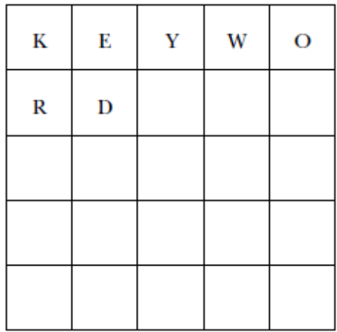
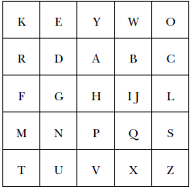
EXAMPLE( 5x5 MATRIX)
Key phrase: KEYWORD
Information Security

Slide 10
EXAMPLE
Plain text: why don’t you
WH YD ON TY OU
Cipher text: YI EA ES VK EZ

Slide 11
EXAMPLE
Plain text: IMPOSSIBLE
IM PO SS IB LE
Regrouping: IM PO SX SI BL EX
Cipher text: QF YS ZQ LQ IC UW
Plain text : IM PO SX SI BL EX
Information Security

Slide 12
EXAMPLE(6 x 6 MATRIX)
Key: KEY WORD
Plain text: MECSE ROOM NO 416
ME CS ER OO MN O4 16
Regrouping: ME CS ER OX OM NO 41 6X
Cipher text: OI TB YK 2K FU RM X7 04
K | E | Y | W | O | R
D | A | B | C | F | G
H | I | J | L | M | N
P | Q | S | T | U | V
X | Z | 0 | 1 | 2 | 3
4 | 5 | 6 | 7 | 8 | 9
Information Security

Slide 13
HILL CIPHER
This multi-letter cipher is developed by the mathematician lester hill in 1929.
An n-gram substitution may define using an invertible nxn matrix A= aij as the key to map an n-character plaintext m1,m2,…mn to a cipher text n-gram
C=E_{K}(X)=KX mod 26
X=D_{K}(C)= K⁻¹C mod 26
For n=3
C1= (k₁₁x₁+k₁₂x₂+k₁₃x₃) mod 26
C1= (k₂₁x₁+k₂₂x₂+k₂₃x₃) mod 26
C1= (k₃₁x₁+k₃₂x₂+k₃₃x₃) mod 26
Information Security

Slide 14
HILL CIPHER (Conti…)
Example: encrypt ‘meet b’ using 2x2 hill cipher with the key k= 3 1
5 2
K⁻¹= 2 -1
-5 3
Plain text will be written as ME ET BX
Letters with there numerical values are as follows
Numerical values for plain text letters are 12 4, 4 19, 1 23
A | B | C | D | E | F | G | H | I | J | K | L | M | N | O | P | Q | R | S | T | U | V | W | X | Y | Z
0 | 1 | 2 | 3 | 4 | 5 | 6 | 7 | 8 | 9 | 10 | 11 | 12 | 13 | 14 | 15 | 16 | 17 | 18 | 19 | 20 | 21 | 22 | 23 | 24 | 25
Information Security

Slide 15
HILL CIPHER (Conti…)
ENCRYPTION
c1 = k11 k12 x x1 mod 26
c2 k21 k22 x2
c1 = 3 1 X 12 mod 26
c2 5 2 4
C1=(36+4) mod 26 = 14 = o
C2=(60+8) mod 26 = 16 = q
C3=(12+19) mod 26 = 5 = f
C4=(20+38) mod 26 = 6 = g
C5=(3+23) mod 26 = 0 = a
C6=(5+46) mod 26 = 25 = z
Encrypted text is : ‘oq fg az’
Information Security

Slide 16
HILL CIPHER (Conti…)
DECRYPTION
X1 = k11 k12 x C1 mod 26
X2 k21 k22 C2
x1 = 2 -1 X 14 mod 26
x2 -5 3 16
x1=(28-16) mod 26 = 12 = m
x2=(-70+48) mod 26 = 4 = e
x3=(10-6) mod 26 = 4 = e
x4=(-25+18) mod 26 = 19 = t
x5=(0-25) mod 26 = 1 = b
x6=(0+75) mod 26 = 23 = x
Decrypted text is : ‘me et bx’
Information Security

Slide 17
HILL CIPHER (Conti…)
Encrypt a message “CIPHER” using 3x3 hill cipher with key=[{2,1,1}, {1,1,2}, {1,0,-2}]
K= 2 1 1
1 1 2
1 0 -2
K⁻¹= 2 -2 -1
-4 5 3
1 -1 -1
Pain text: CIP HER
Cipher text: BOY JIP
Information Security

Slide 18
VIGENERE CIPHER
In a Caesar cipher, each letter of the alphabet is shifted along some number of places; for example, in a Caesar cipher of shift 3, A would become D, B would become E and so on.
The Vigenère cipher consists of several Caesar ciphers in sequence with different shift values.
To encrypt, a table of alphabets can be used, termed a tabula recta, Vigenère square, or Vigenère table
It consists of the alphabet written out 26 times in different rows, each alphabet shifted cyclically to the left compared to the previous alphabet, corresponding to the 26 possible Caesar ciphers.
Information Security

Slide 19
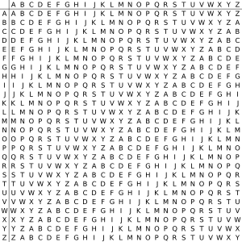
VIGENERE CIPHER (Conti…)
Plain text: ATTACKATDAWN
Key: LEMON
Cipher text :LXFOPVEFRNHR
A | T | T | A | C | K | A | T | D | A | W | N
L | E | M | O | N | L | E | M | O | N | L | E
Information Security

Slide 20
VIGENERE CIPHER (Conti…)
Plaintext: information security
Key: confidential
Encryption: KBSTZPEGBWNDGQHWQWC
Plaintext: crypto is for cryptography
Key: abcdef
Encryption: CSASXTITHRVHRZRWSLRBRKC
Information Security

Slide 21
VIGENERE CIPHER (Conti…)
Vigenère can also be viewed algebraically. If the letters A–Z are taken to be the numbers 0–25, and addition is performed modulo 26, then Vigenère encryption can be written,
Decryption
Information Security

Slide 22
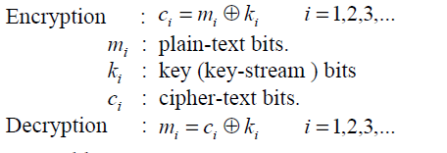
VERNAM CIPHER
Gilbert vernam in 1918 devised a system that works on binary data rather than letters.
Vernam proposed the use of running tape that eventually repeated the key, so that the system can work with a very but repeating keys
Information Security

Slide 23
ONE-TIME PAD
Major joseph mauborgne-an army signal corp. officer, invented it by proposing improvement in vernam cipher.
A one-time pad (OTP) is a large no repeating set of truly random key letters, written on sheet of paper, and glued together in a pad.
The sender uses each key letter on the pad to encrypt exactly one plain text character.
The sender encrypts the message and then destroys the used pages of the pad.
The receiver has an identical pad and uses each letter on the pad, in turn, to decrypt each letter of cipher text.
The receiver destroys the same used pages of the pad after decrypting the message.
It produces random output that bears no statistical relationship to the plaintext so there is no way to break the code.
Information Security

Slide 24
CRYPTOGRAPHIC CODE
Ciphers are encryption techniques, which are applied to plain text units independent of their semantic or linguistic meaning; the result is called cipher text.
Cryptographic codes operate on semantic units such as words, groups of words, or phrases, and substitute (replace) these by designated words, letter groups, or number groups called code groups.
The key is a dictionary-like codebook listing plain text units and their corresponding code groups, indexed by the former; a corresponding codebook for decoding is reverse-indexed.
Several factors suggest that codes may be more difficult to break than cipher: the key (codebook) is vastly larger than typical cipher keys; codes may result in data compression; and statistical analysis is complicated by the large plain text unit block.
Information Security

Slide 25
CRYPTOGRAPHIC CODE (Conti…)
Major disadvantages: the coding operation not being easily automated; and identical encryption of repeated occurrences of plain text units implies susceptibility to known plain text attacks, and allows frequency analysis based on observed traffic.
This implies a need for frequent changing of the codebook, which is both more costly and inconvenient. Consequently, codes are not commonly used to secure modern telecommunications.
Information Security

Slide 26
CRYPTANALYSIS
Cryptanalysis is the study of mathematical techniques for attempting to defeat cryptographic techniques that provide information security services.
Typically, the objective of attacking an encryption system is to recover the key in use rather then simply to recover the plain text.
general approaches:
  cryptanalytic attack
  brute-force attack
Information Security

Slide 27
CRYPTANALYSIS (Conti…)
Cryptanalytic attacks
Cryptanalytic attacks rely on the nature of the algorithm plus perhaps some knowledge of the general characteristics of the plain text or even some sample plaintext-ciphertext pairs.
This type of attack exploits the characteristics of the algorithm to attempt to deduce a specific plaintext or to deduce the key being used.
Ciphertext only attack
  Encryption algorithm
  Ciphertext
Information Security

Slide 28
CRYPTANALYSIS (Conti…)
Known plaintext attack
  Encryption algorithm
  Ciphertext
  One or more plaintext-ciphertext pair formed with the secret key
Chosen plaintext attack
  Encryption algorithm
  Ciphertext
  Plaintext message chosen by cryptanalyst, together with its corresponding ciphertext generated with the secret key.
Chosen ciphertext attack
  Encryption algorithm
  Ciphertext
  Purported ciphertext chosen by cryptanalyst, together with its corresponding decrypted plaintext generated with the secret key
Information Security

Slide 29
CRYPTANALYSIS (Conti…)
Chosen text attack
  Encryption algorithm
  Ciphertext
  Plaintext message chosen by cryptanalyst, together with its corresponding ciphertext generated with the secret key.
  Purported ciphertext chosen by cryptanalyst, together with its corresponding decrypted plaintext generated with the secret key
Information Security

Slide 30
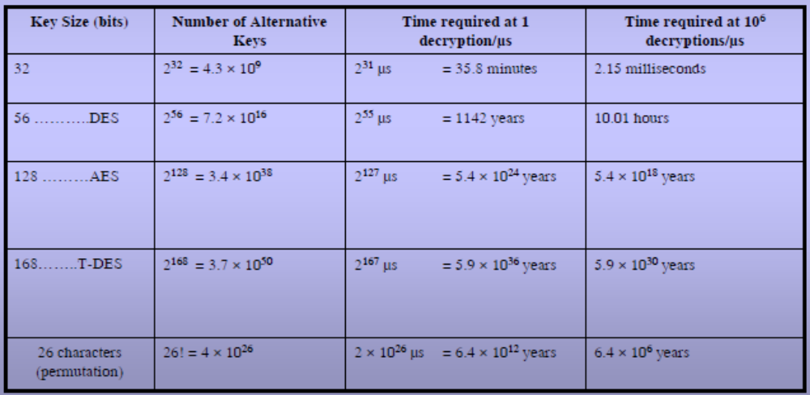
CRYPTANALYSIS (Conti…)
Brute-force attack
A brute-force attack involve trying every possible key until an intelligible translation of the ciphertext into plaintext is obtained.
Information Security

Slide 31
Unconditional Security
An encryption scheme is unconditionally secure if the ciphertext generated by the scheme dose not contain enough information to determine uniquely the corresponding plaintext, no matter how much ciphertext is available.
That is, no matter how much computer power or time is available, the cipher cannot be broken since required information is not there.
There is no encryption algorithm that is unconditionally secure.
Information Security

Slide 32
Computational Security
An encryption scheme is said to be computationally secure if either of the following two criteria are met.
  The cost of breaking the cipher exceeds the values of the encrypted information.
  The time required to break the cipher exceeds the useful lifetime of the information.
Information Security

Slide 33
Monoalphabetic cipher
With only 25 possible keys, the caesar cipher is far from the security
If instead of using 26 alphabetic character in sequences, if we do the permutation of 26 character then 26!=4X10²⁶ keys are possible and it is difficult to check all those key and this approach is known as monoalphabetic substitution cipher.
Information Security

Slide 34

English Letter Frequencies
Information Security

Slide 35
cryptanalysis
discovered by Arabian scientists in 9th century
key concept - monoalphabetic substitution ciphers do not change relative letter frequencies
calculate letter frequencies for ciphertext
compare counts/plots against known values
Information Security

Slide 36
cryptanalysis
given ciphertext:
  UZQSOVUOHXMOPVGPOZPEVSGZWSZOPFPESXUDBMETSXAIZ
  VUEPHZHMDZSHZOWSFPAPPDTSVPQUZWYMXUZUHSX
  EPYEPOPDZSZUFPOMBZWPFUPZHMDJUDTMOHMQ
guess P & Z are e and t
P :13.33 Z :11.67 S :8.33 U :8.33 O :7.50 M :6.67 | H:5.83 D:5.00 E:5.00 V:4.17 X:4.17 | F:3.33 W:3.33 Q:2.50 T:2.50 A:1.67 | B:1.67 G:1.67 Y:1.67 I:0.83 J:0.83 | C :0.00 K :0.00 L :0.00 N :0.00 R :0.00
Information Security

Slide 37
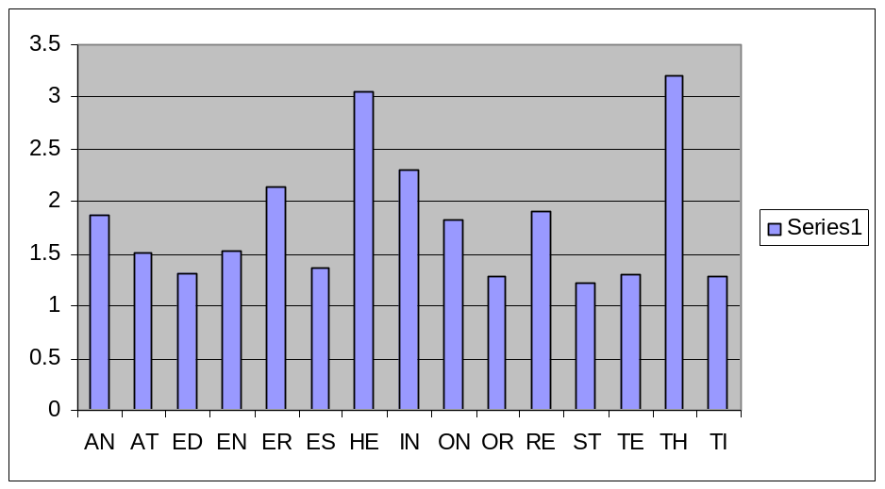
cryptanalysis
Frequency of 15 common diagrams in English text.
guess ZW is th and hence ZWP is the
proceeding with trial and error finally get:
  it was disclosed yesterday that several informal but
  direct contacts have been made with political
  representatives of the viet cong in moscow
Information Security

Slide 38
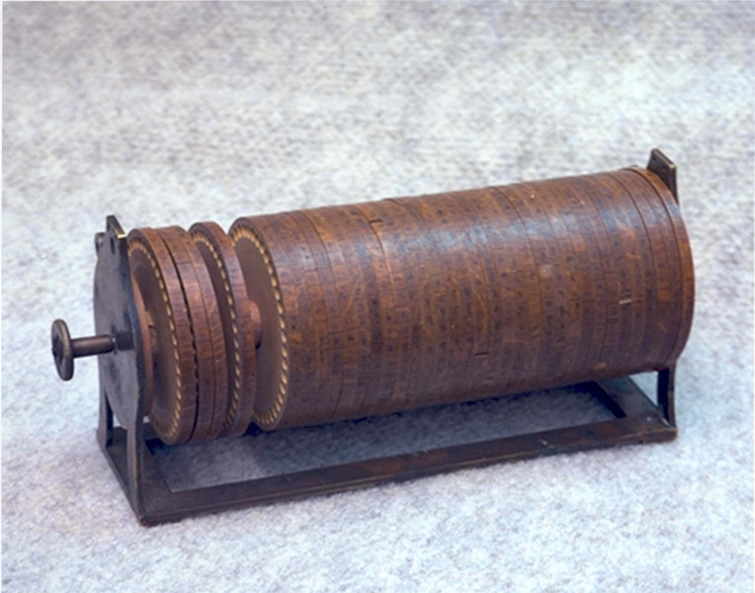
Machine cipher
Jefferson cylinder
Information Security

Slide 39
Machine cipher
Rotor-based machines
Multiple stages of encryption can produce an algorithm that is significantly more difficult to cryptanalyze-principle of rotor-based machine .
Machines based on the rotor principle were used by both Germany (Enigma) and Japan (Purple) in world war-II
A plain text character input to the first rotor generates an output which is input to the second rotor, and so on, until the final ciphertext character emerges from the last
Information Security

Slide 40
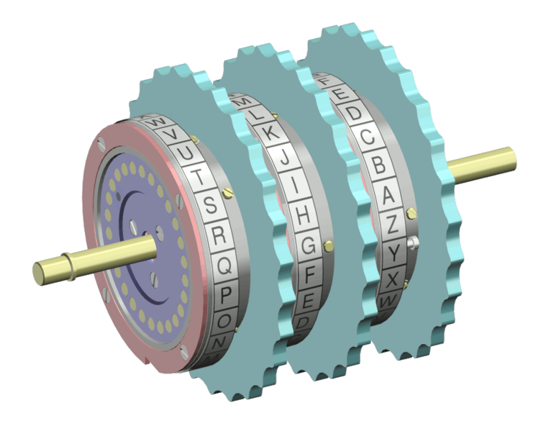
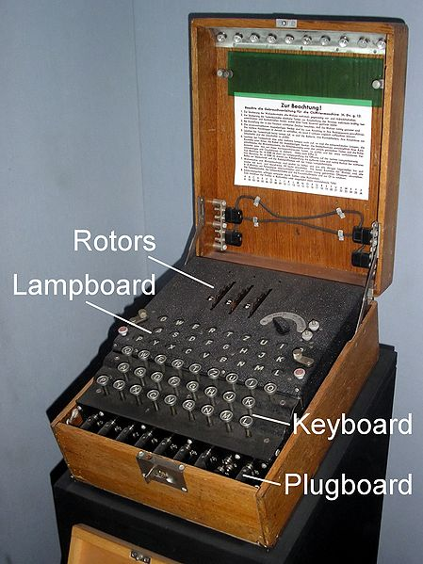
Machine cipher (Conti…)
Information Security

Slide 41
Steganography
Steganography is the art and science of writing hidden messages in such a way that no one apart from the intended recipient knows of the existence of the message.
Cryptography relies on transformation algorithms using key to scramble a message.
Steganography takes one piece of information and hides it within another.
Both are used to protect information but steganography is concerned with hiding information thereby making it unseen while cryptography is concerned with encrypting information thereby making it unreadable.
Some example of steganography from the past are:
Character marking: where selected letters of text are overwritten with a special pencil. The marks are ordinarily not visible unless the paper is held at an angle to bright light.
Use of invisible ink.
Pin punctures.
Information Security

Slide 42
Steganography (Conti…)
Audio steganography
Video steganography
Textual steganography
Real-time steganography
Information Security

Slide 43
TOPICS
E-Commerce: e-cash, e-auctions, micro transactions,…
Embedded System Security Paradigms
Biometric Security
Steganography
IPv6, IPSEC
Adhoc and Sensor network security
Security of Computational Grids …
Quantum Cryptography, …
Network intrusion detection system
Database intrusion detection system
Protocol verification
Security issues in cloud computing
Grid computing
Information Security

Slide 44
Practical Assignment
Write a program to implement a caesar cipher technique
Write a program to implement a rail fence technique
Write a program to implement a simple transposition technique
Write a program to implement a cryptanalysis tool for caesar cipher
Information Security

